Slide 1
GARMENTS INVENTORY MANAGEMENT SYSTEM

Slide 2
GRAPHICAL USER INTERFACE

Slide 3
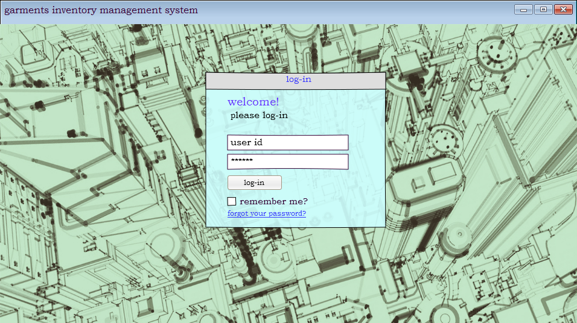
welcome screen

Slide 4
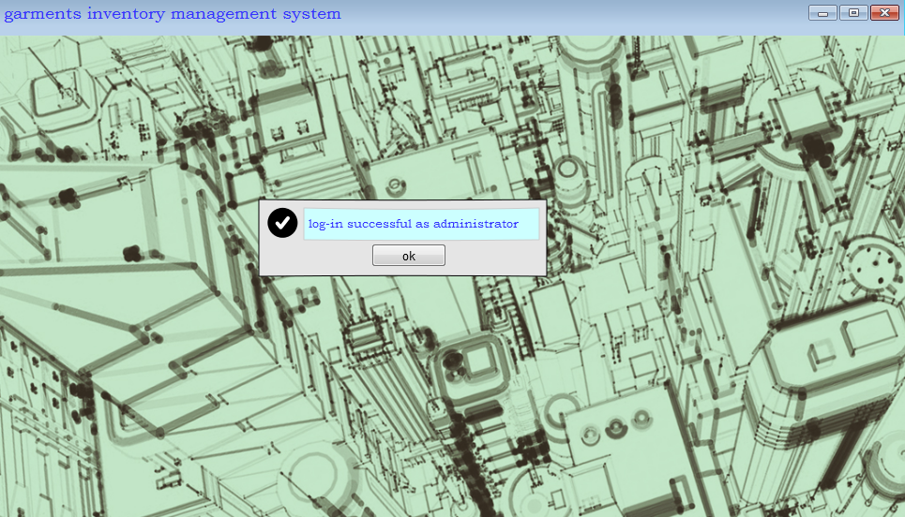
if Log-in successful

Slide 5
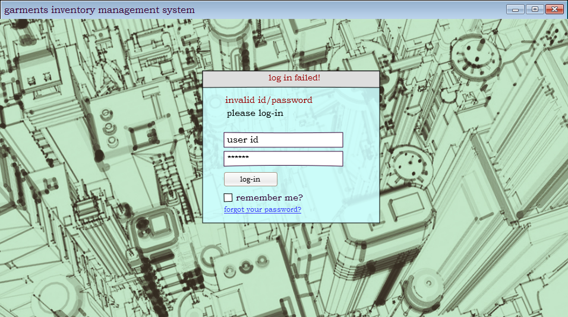
if Log-in not successful

Slide 6
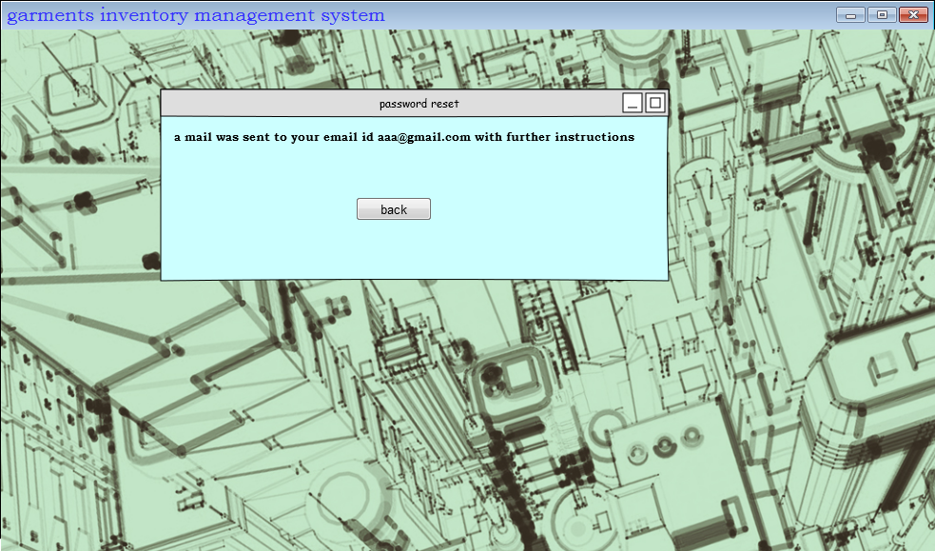
If the user clicks ‘forgot your password’

Slide 7
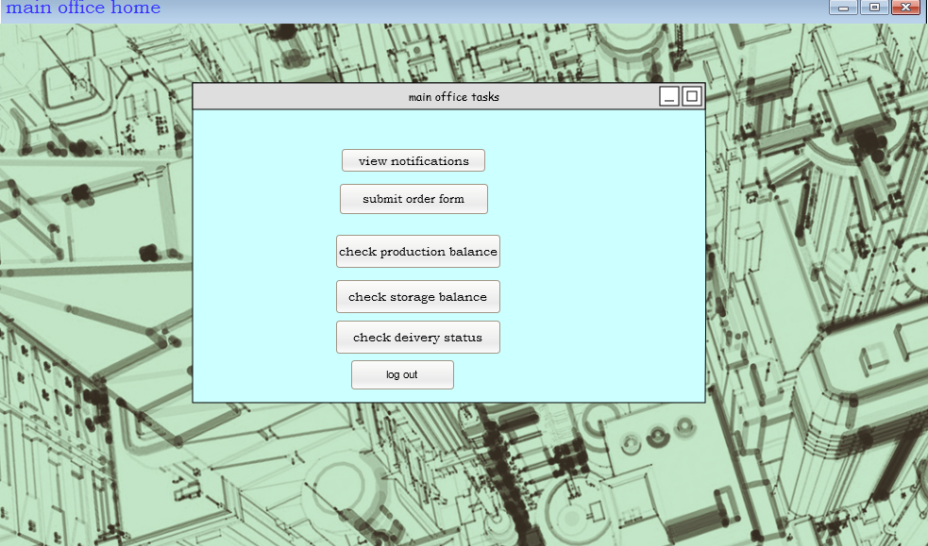
Main office home

Slide 8
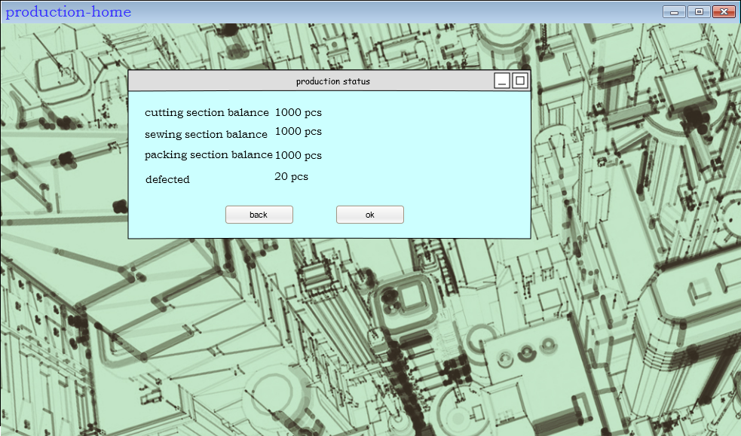
check production balance

Slide 9
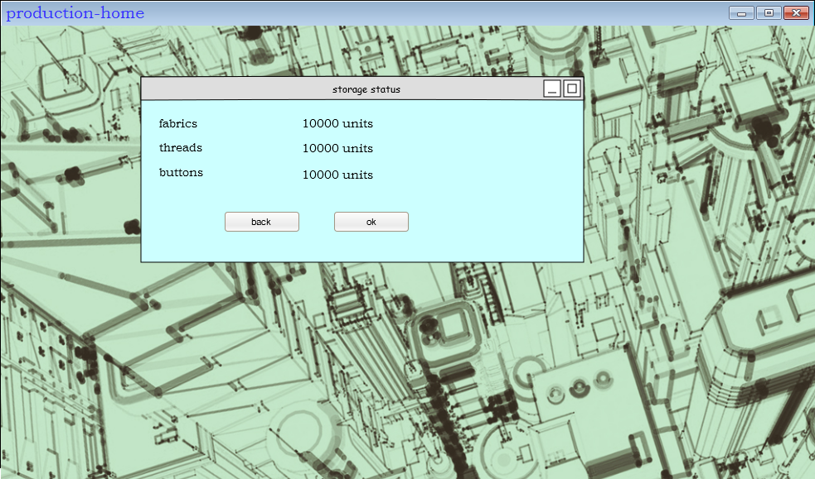
Check storage balance

Slide 10
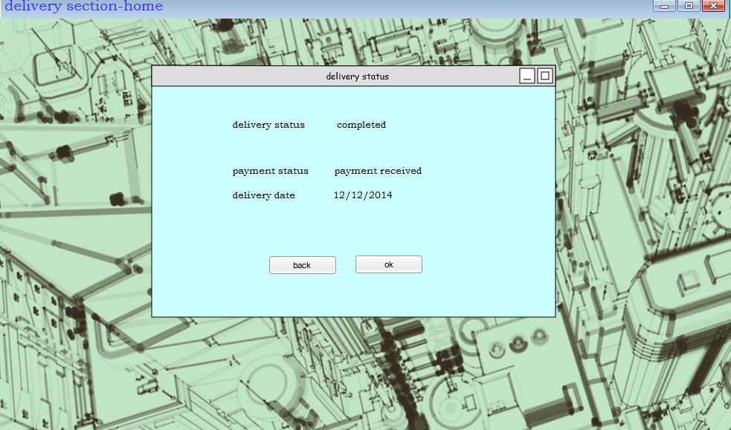
Check delivery status

Slide 11
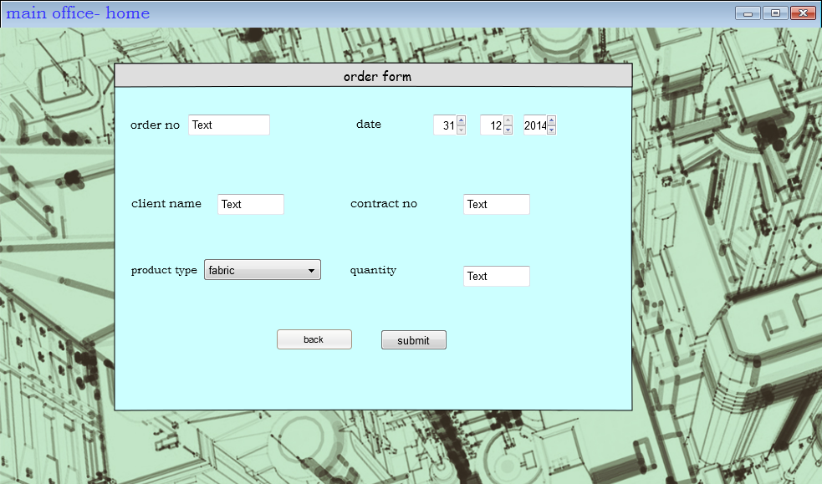
submit order form

Slide 12
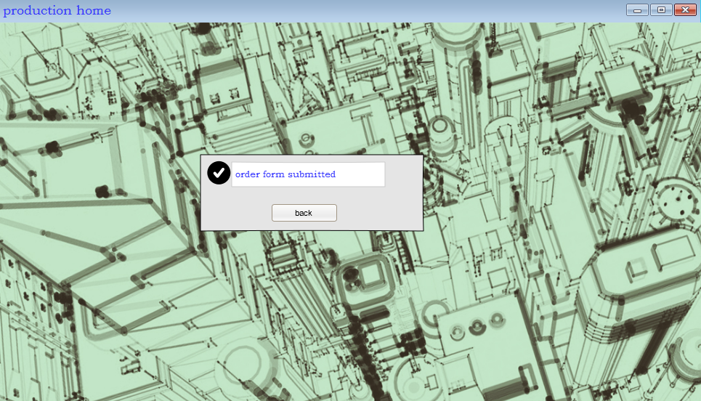
order form submitted successfully

Slide 13
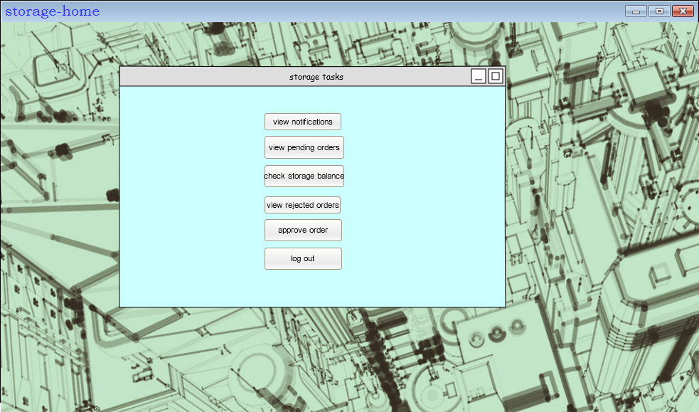
storage menu

Slide 14
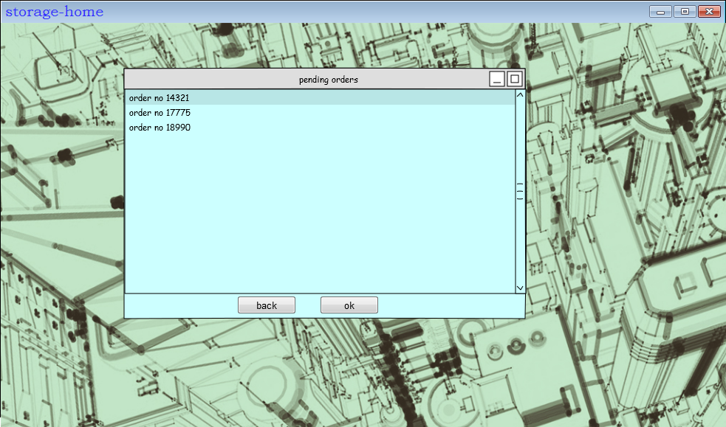
view pending orders

Slide 15
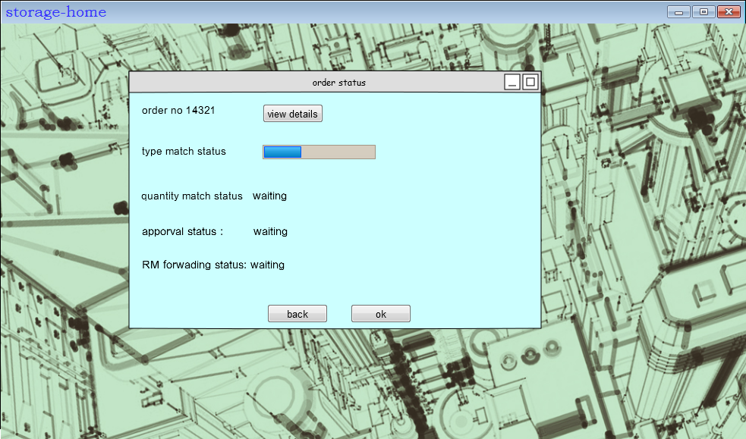
after selecting a form

Slide 16
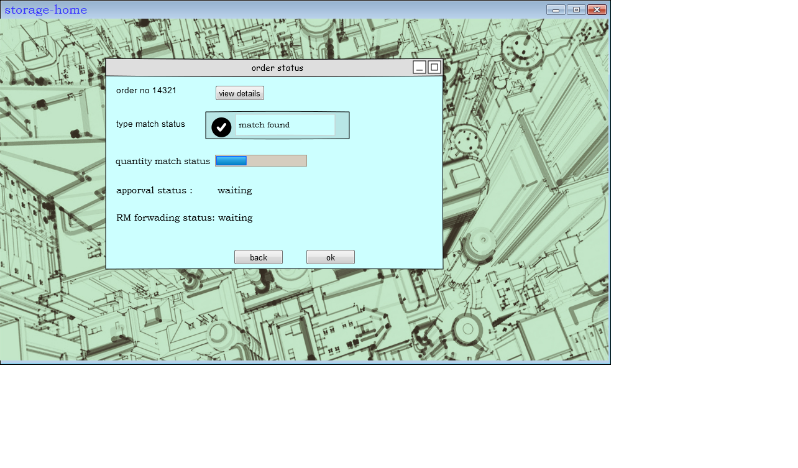
match type successful

Slide 17
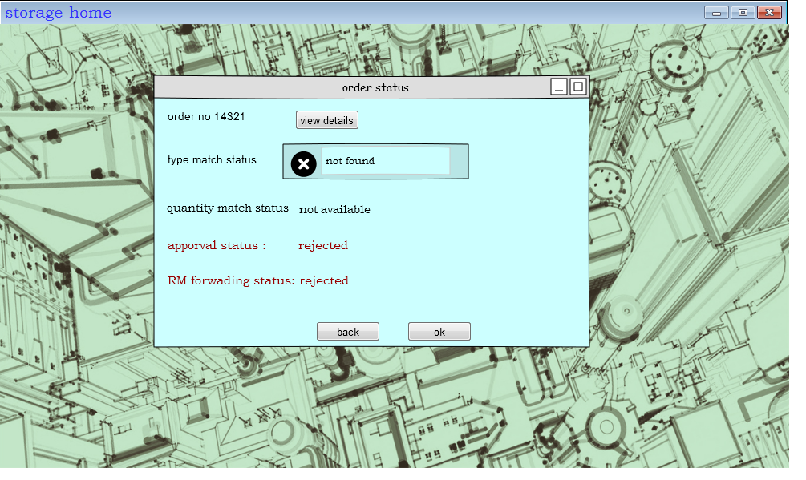
match type not successful

Slide 18
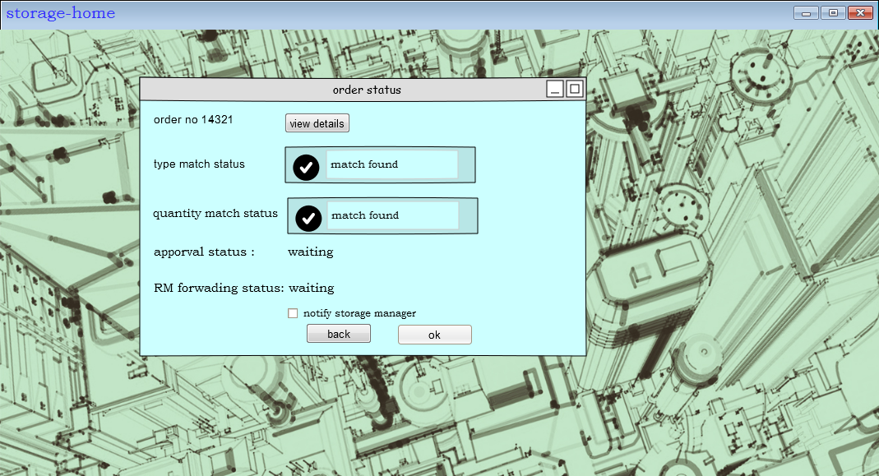
match quantity successful

Slide 19
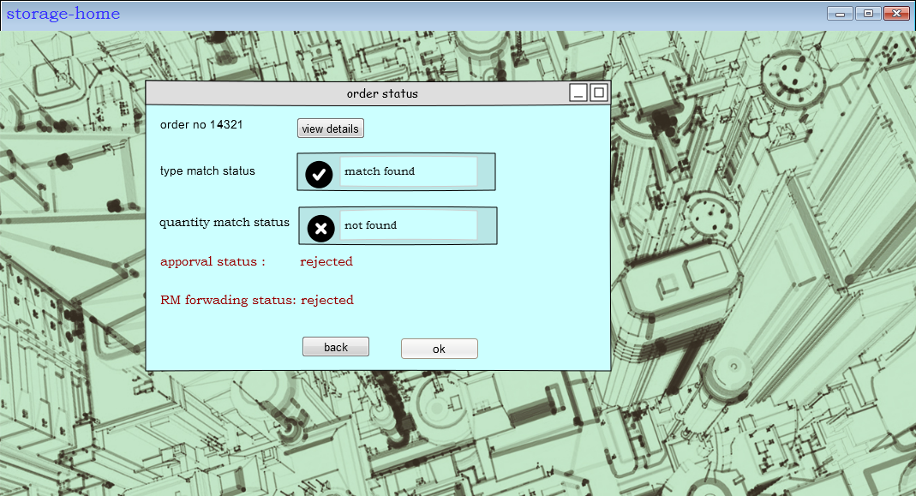
Match quantity not successful

Slide 20

view notifications

Slide 21
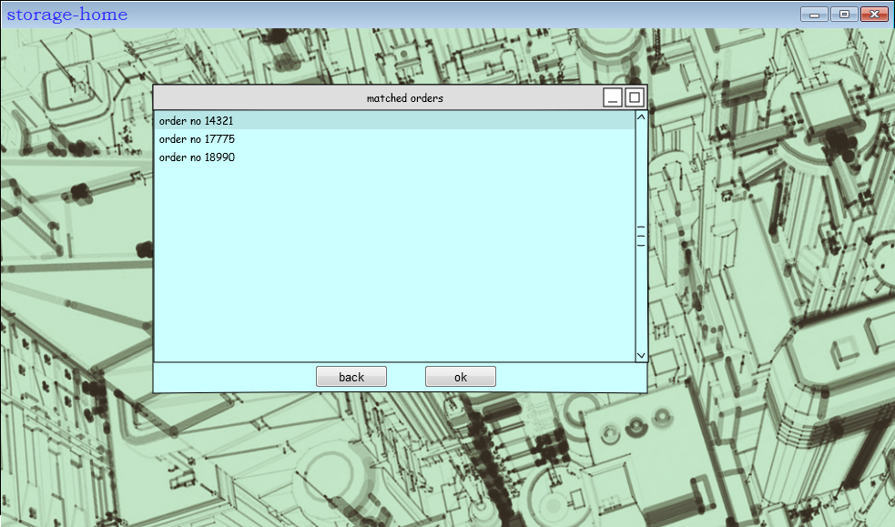
approve order

Slide 22
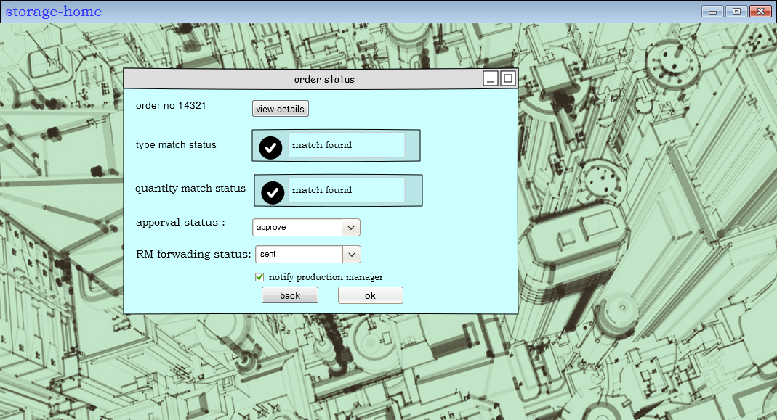
After selecting a form

Slide 23
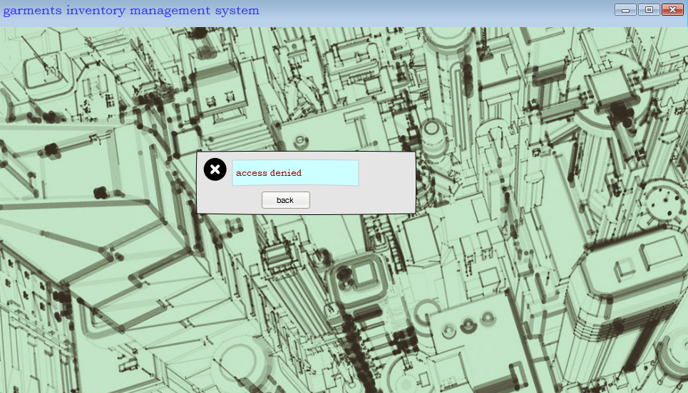
If user is not authorized

Slide 24
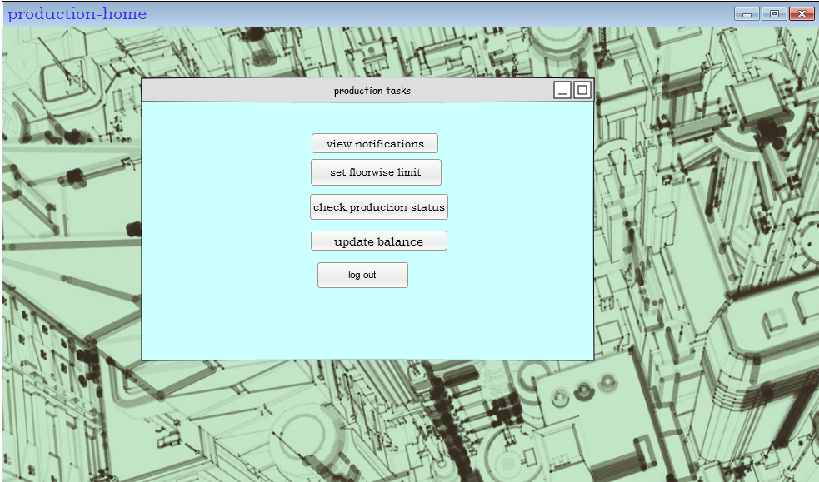
Production home

Slide 25
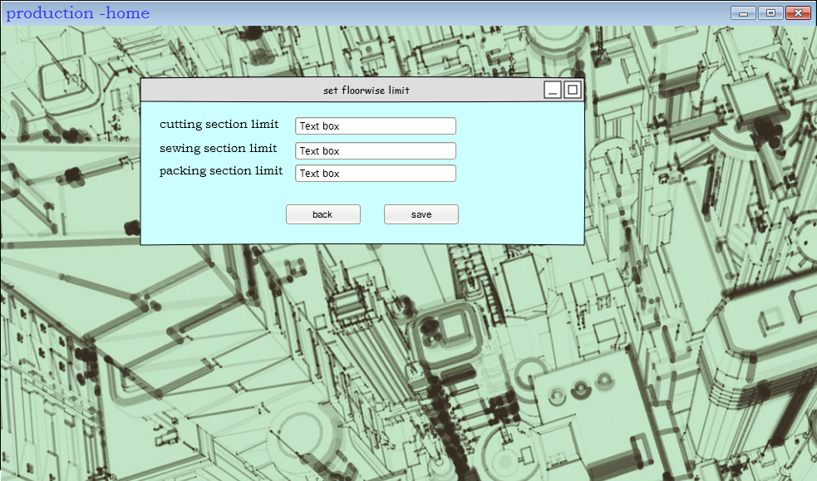
Set floor wise limit

Slide 26
check production status

Slide 27
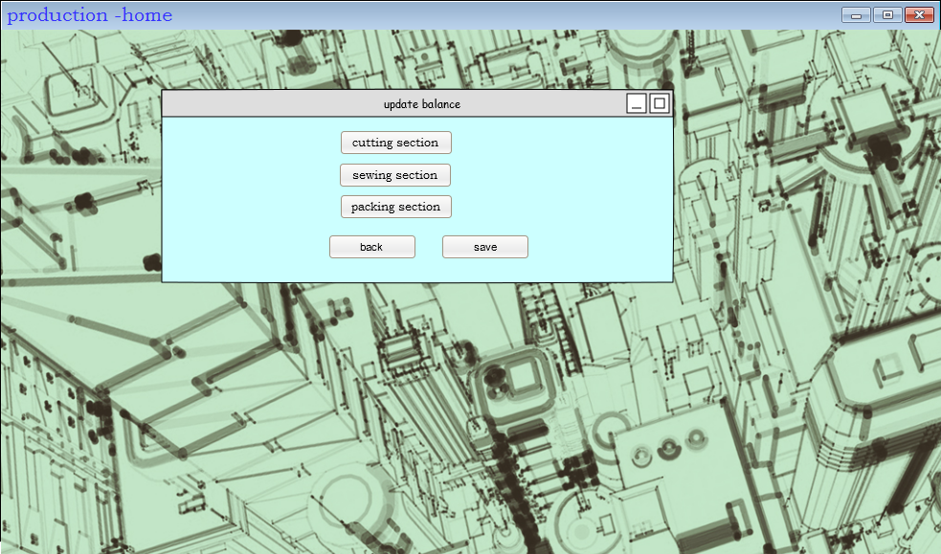
update production status

Slide 28
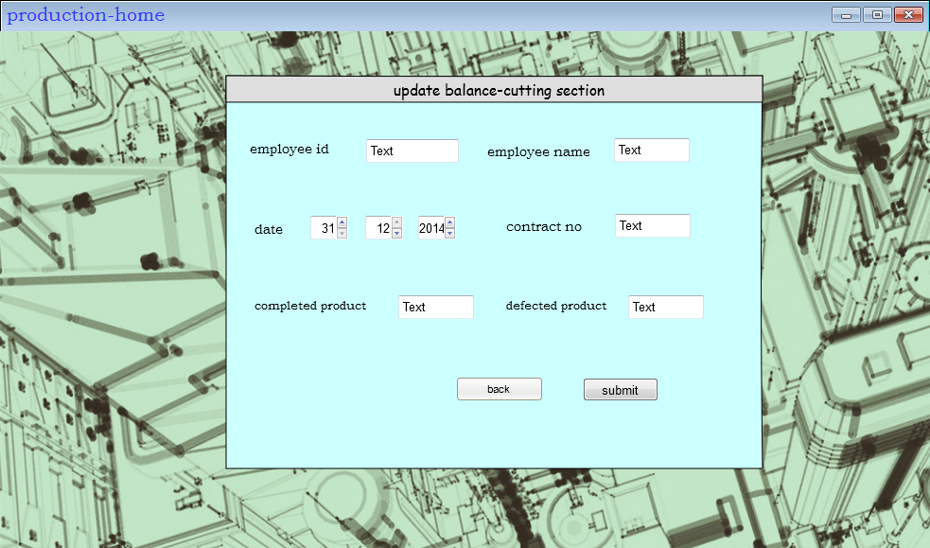
Updating the cutting section balance

Slide 29

Updating the sewing section balance

Slide 30
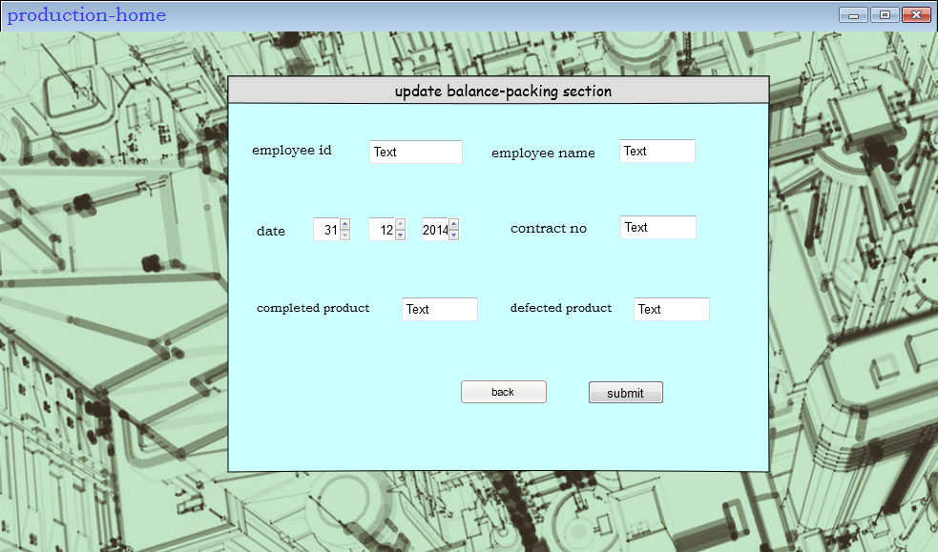
Updating the packing section balance

Slide 31

Balance updated successfully:

Slide 32
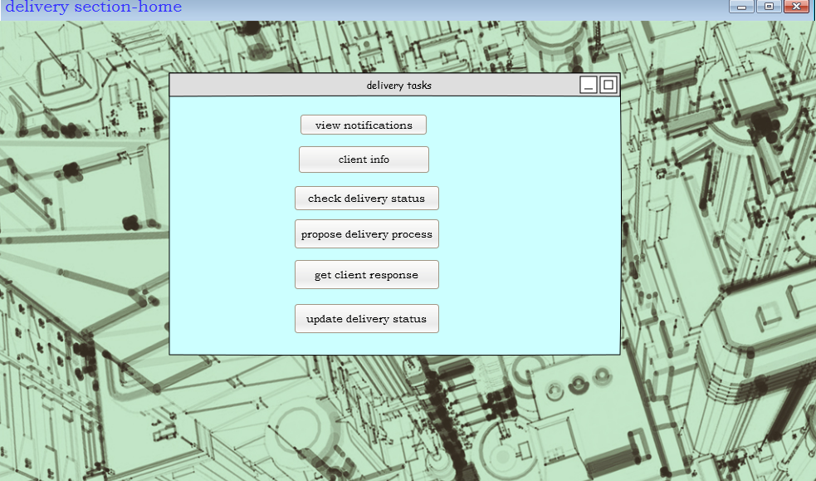
delivery section menu

Slide 33
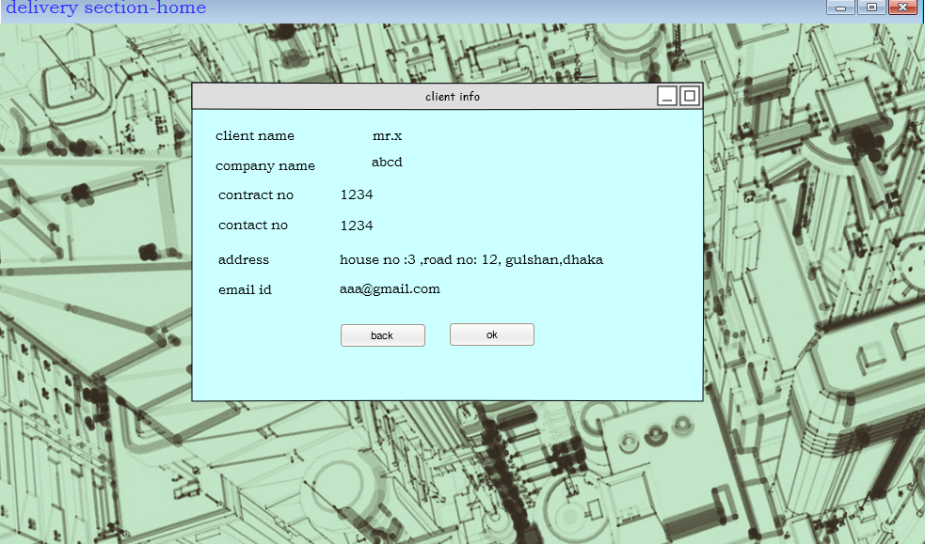
client info

Slide 34
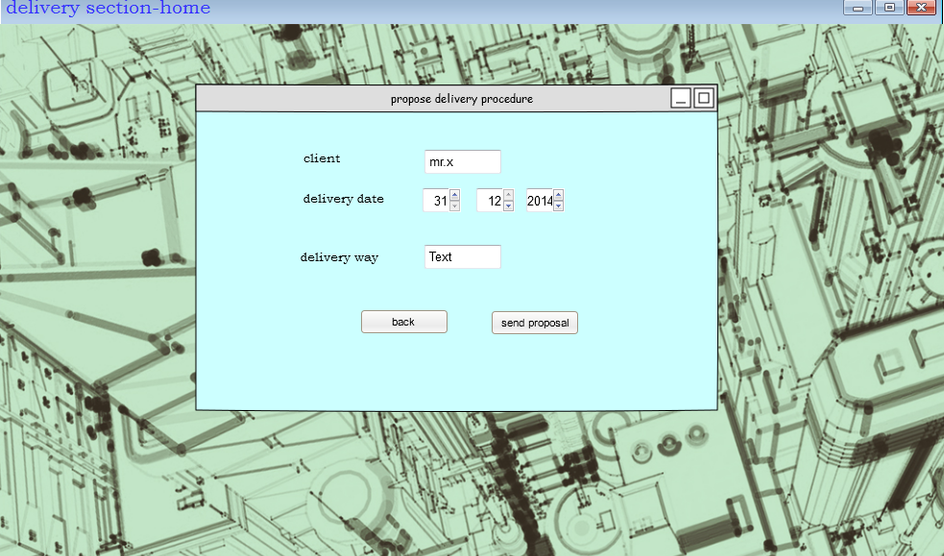
propose delivery process

Slide 35
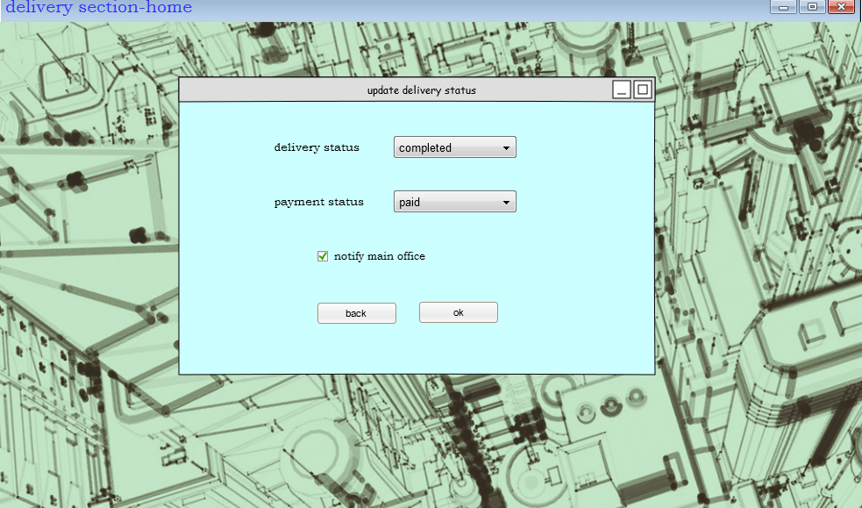
update delivery status

Slide 36
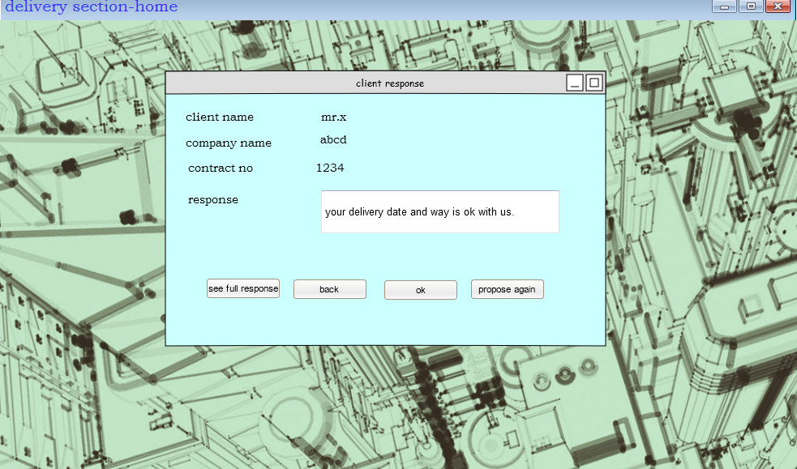
get client response

Slide 37
Check delivery status

